Slide 1

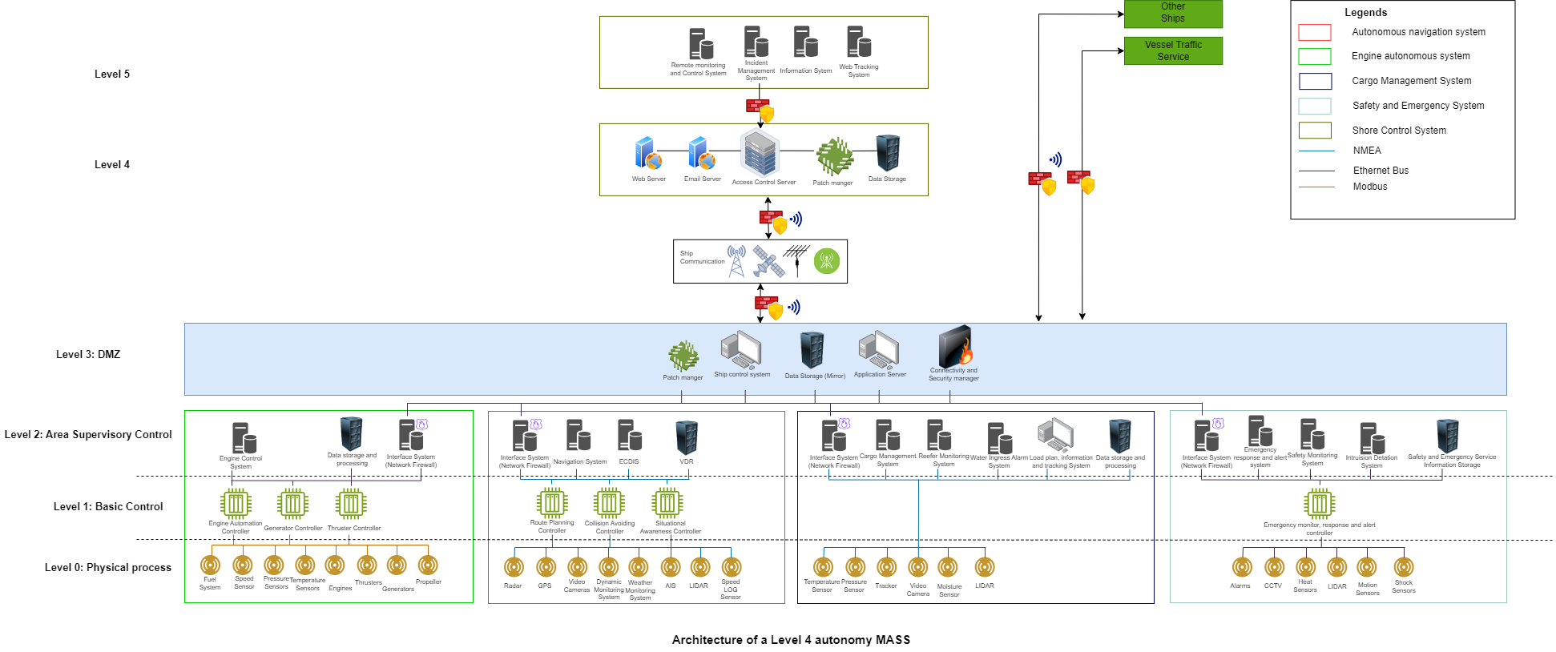
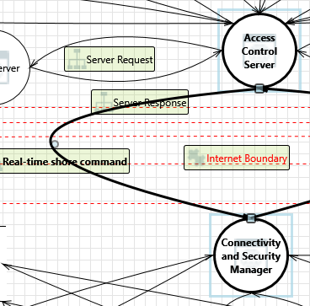
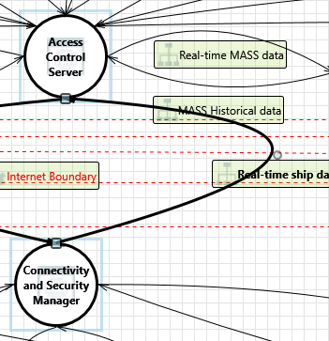
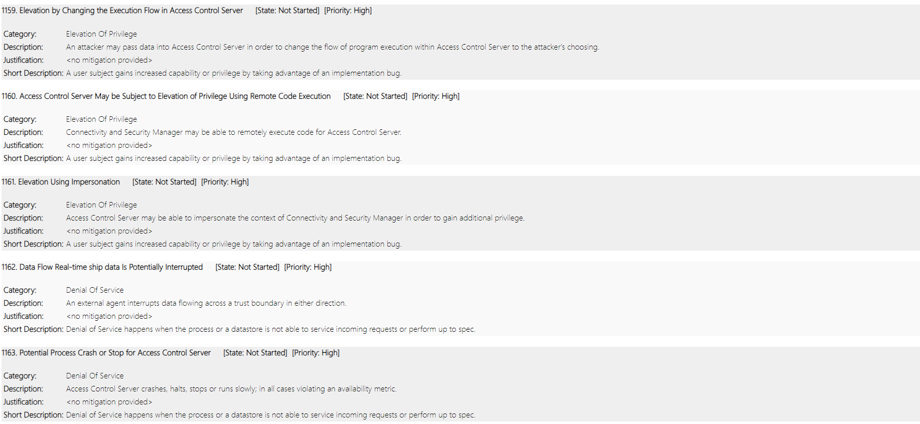
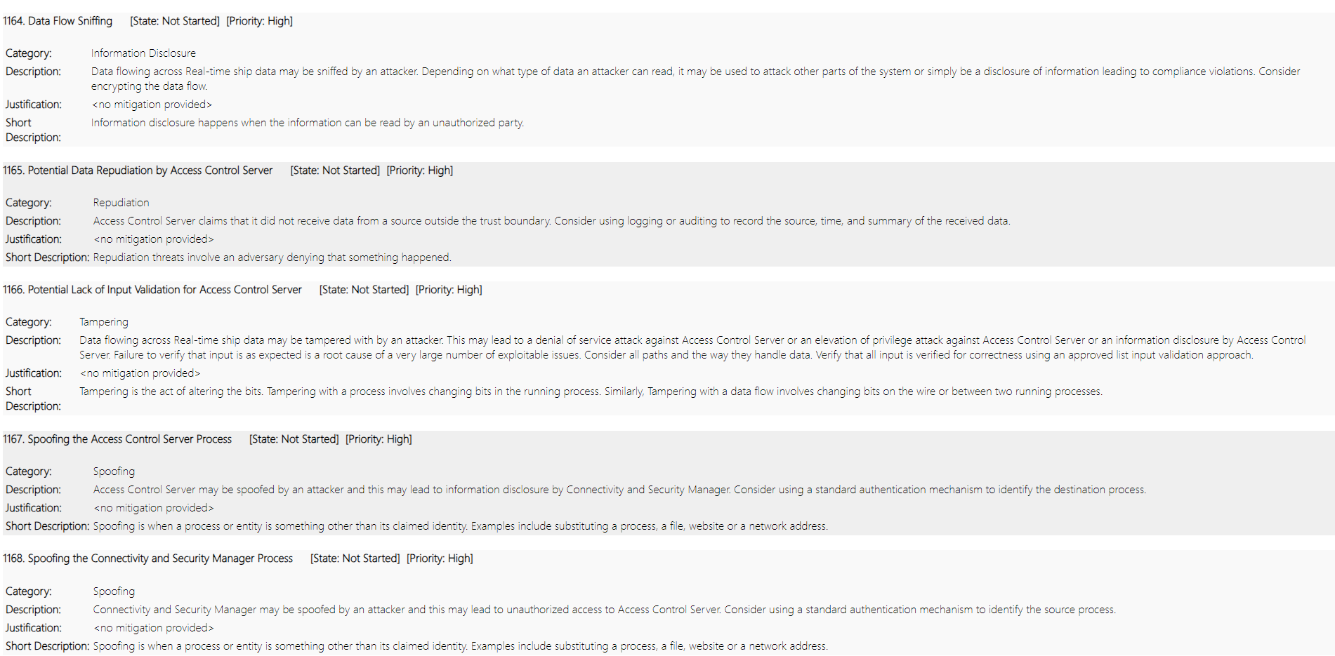
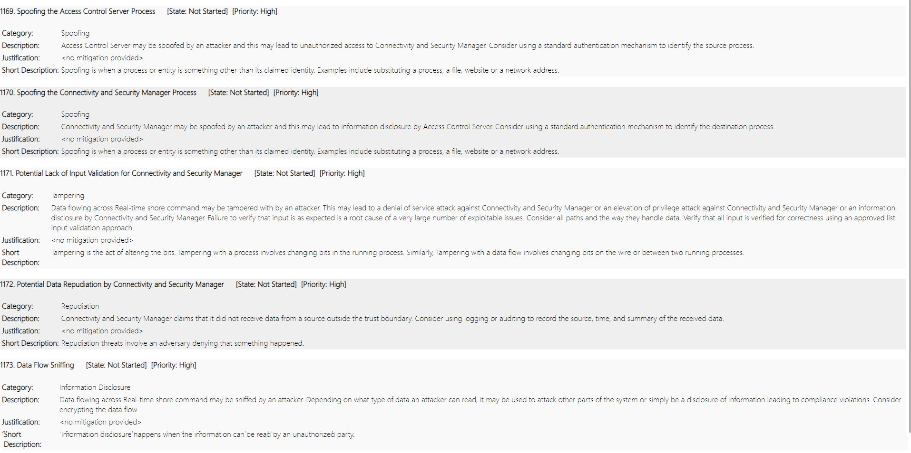
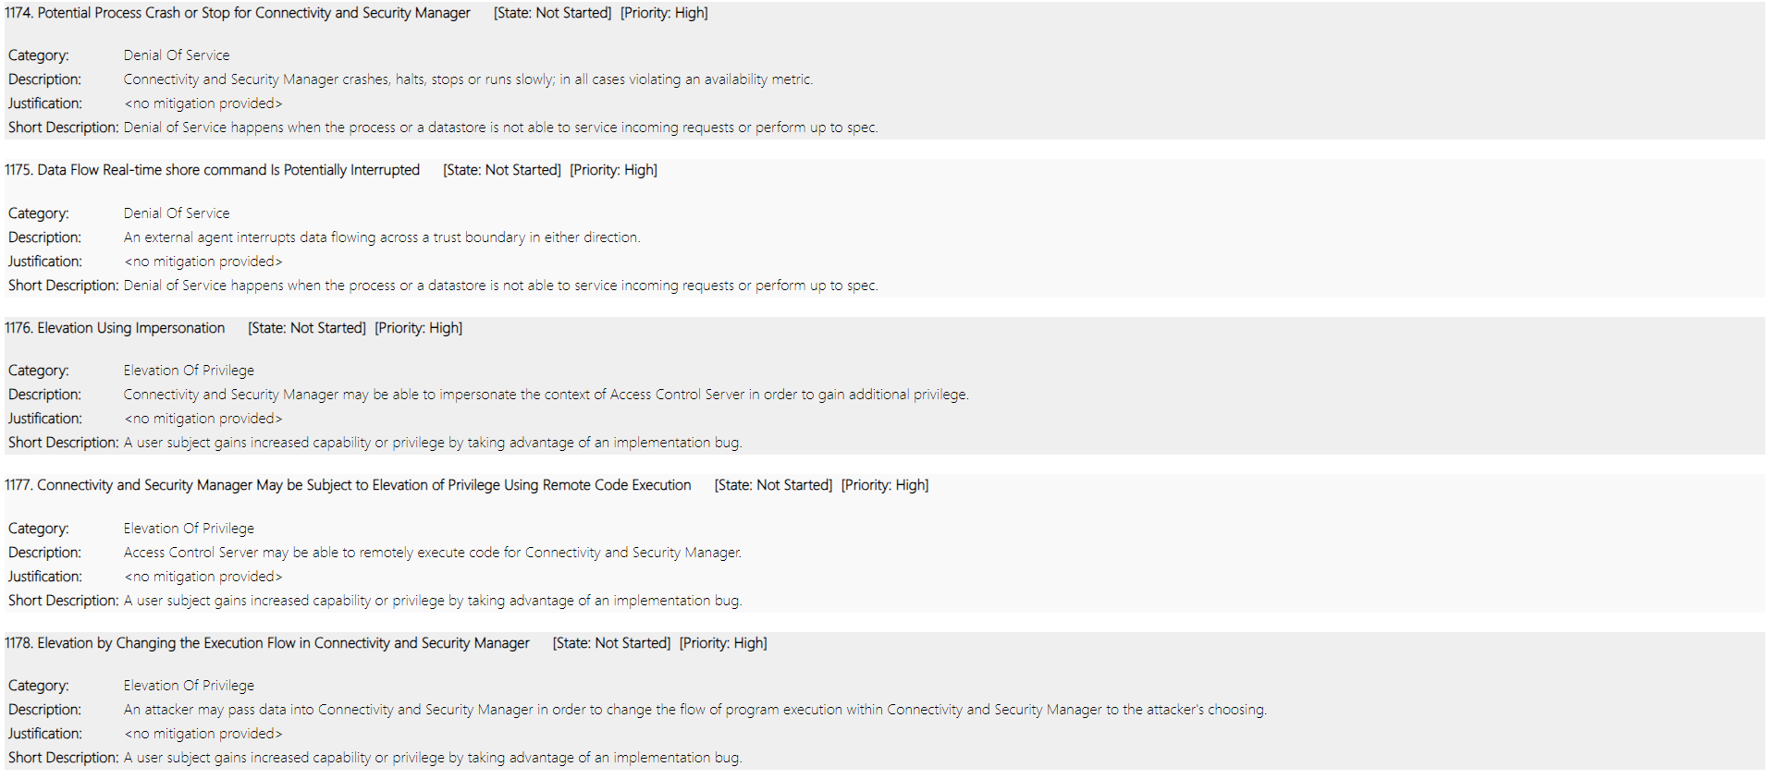
Cybersecurity: Threat Modeling of Maritime Autonomous Surface Ship (MASS)
Dikshant Devkota¹; Prof. Ravishankar Bhaskarrao Borgaonkar²;
University of Stavanger
Abstract
Research Questions
What are the various IT and OT components that effectively integrate to enhance the autonomous operation of Maritime Autonomous Surface Ships (MASS)?
How can threat modeling methodologies be optimized to assess vulnerabilities in MASS effectively?
Methodologies
1. ISO/IEC 27005: Offers guidelines for information security risk management, providing a flexible framework adaptable to various organizational needs. [3]
2. STRIDE: A classification tool identifying potential threats based on Spoofing, Tampering, Repudiation, Information Disclosure, Denial of Service, and Elevation of Privilege. [2]
Limitations
The study does not cover the legal and regulatory frameworks influencing the threat landscape, leaving out an important aspect of MASS operation.
The threat model is based on academic research articles due to the lack of comprehensive industry white papers, potentially missing unique risks and industry-specific anomalies.
Discussion
The maritime industry has been advancing rapidly with the development of Maritime Autonomous Surface Ships (MASS), which use advanced communication, IT, and OT networks to navigate through the ocean.
This thesis explores the interdependence and complexity of these components, highlighting potential cyber threats. It also presents a comprehensive analysis of threat modeling, emphasizing the importance of understanding threat actors, resources, vulnerabilities, and consequences of successful cyber-attacks.
The thesis advocates for a thorough threat modeling template and cyber-security awareness to protect MASS and save money for the maritime sector.
The interaction between the Access Control System (Shore) and the Connectivity and Security Manager (Ship) is crucial for the safe operation of MASS. However, it is vulnerable to threats such as spoofing, tampering, repudiation, information disclosure, and DoS and elevation of privilege attacks.
To mitigate these risks, strong authentication protocols, encryption, and traffic control mechanisms should be implemented. End-to-end encryption using algorithms are essential for data integrity.
A dynamic approach integrating advanced security technologies and best practices in cybersecurity is vital for the safe and secure operation of autonomous maritime systems.
Fig 1. MASS ICT Architecture.
Fig 2. Data Flow Diagram between Shore Control Center and Ship
Conclusions
Maritime Autonomous Surface Ships (MASS) are a significant advancement in maritime technology, enhancing economic development by automating navigation, optimizing cargo management, and improving safety protocols.
However, they also present new cybersecurity risks, necessitating constant vigilance and proactive measures. To maximize MASS's potential, stakeholders must leverage advanced technologies and implement robust cybersecurity strategies. Continued research, collaboration, and investment in cybersecurity are crucial for sustainable integration.
Introduction
The maritime industry is increasingly utilizing industrial control systems to develop autonomous systems, such as MASS. These ICT-based ships are vulnerable to sophisticated cyber-attacks, which can compromise device operation, information leakage, and loss of life.
This thesis aims to create a Microsoft Threat Modeling Tool template MASS to help asset managers and architectures identify potential threats before developing and deploying a ship [1]. The template will list potential threats, making it easier for asset users and architectures to classify them and plan mitigation strategies.
Threat modeling, a technique used in software development, has not been widely applied to cyber-physical systems like MASS [2]. The primary objective is to develop a threat modeling framework for MASS, while the secondary goal is to identify IT/OT components and threats involving them.
Future Directions
Real-time Threat Intelligence Integration: Up-to-date information on emerging cyber threats.
Automated Risk Assessment: Streamlined risk assessment process for rapid identification and prioritization.
Cloud-Based Collaboration Features: Enables real-time collaboration on threat modelling activities for geographically dispersed teams.
Fig 3. List of threats between Access Control Server of Shore Control Center and Connectivity and Security Manager of Ship
Contact Information
References
Acknowledgements
Dikshant Devkota
Email: d.devkota@stud.uis.no
Website: linkedin.com/in/dikshant15/
Ben Farah, Mohamed Amine et al. (2022). “Cyber Security in the Maritime Industry: A Systematic Survey of Recent Advances and Future Trends”. In: Information 13.1. ISSN: 2078-2489. DOI: 10 . 3390 / info13010022. URL: https : / / www.mdpi.com/2078-2489/13/1/22.
Shostack, Adam (2014). Threat modeling: Designing for security. John Wiley & Sons.
ISO/IEC JTC 1/SC 27 (Oct. 2022). Information Security, Cybersecurity and Privacy Protection — Guidance on Managing Information Security Risks. Geneva, Switzerland: International Organization for Standardization. URL: https : / / www . iso . org /standard/80585.html.
I would like to thank Professor Ravishankar Bhaskarrao Borgaonkar for his invaluable guidance, Lars Halvden Flå for his crucial feedback and guidance, and the Department of Electrical Engineering and Computer Science at the University of Stavanger for the opportunity to undertake this project.

